Slide 1
Proposed Work: Alphabet Partitioning Dr. Abhishek Kumar

Slide 2

Parameters:
Average code length: We define the average code word length of the source encoder as
$$\overline{L}=\sum_{k=0}^{K−1}{p_{k}l_{k}}$$
Entropy: It is defined as Avg. codeword length (minimum when $l_{k}=\text{log}\text{2}\text{(}\frac{1}{pk}\text{)}$) i.e.,
$H =L_{min}=\sum_{k=0}^{K−1}{pk}$ log₂($\frac{1}{pk}$)
Coding efficiency can be defined as
$η=\frac{L_{min}}{\overline{L}}$, and $r=1− η$

Slide 3
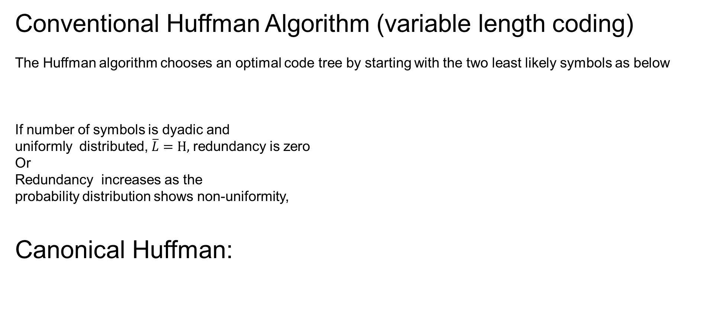
Conventional Huffman Algorithm (variable length coding)
The Huffman algorithm chooses an optimal code tree by starting with the two least likely symbols as below
If number of symbols is dyadic and
uniformly distributed, $\overline{L}=H,$redundancy is zero
Or
Redundancy increases as the
probability distribution shows non-uniformity,
Canonical Huffman:
Now, instead entire Huffman, we need to store symbols in
increasing order by their bit length and number of symbols
for each bit length. This algorithm further reduces redundancy.

Slide 4
[Amir Said]…, Symbol Grouping
[Amir Said]…, Symbol Grouping, Proposed

Slide 5
Grouping Redundancy:
On the basis of above expression, Author uses optimal condition in rest of the
Paper:
Find the partitions of source with the smallest number of group, for the complexity minimization.
A necessary optimal condition to ascertain optimality.
Optimal partitioning via dynamic programming
In addition, some mathematical properties
Finally, analysis of the computational complexity is given.

Slide 6
Gaps:
As per my survey, for alphabet portioning, Huffman algorithms is not proposed yet to achieve same avg. code-word length as conventional Huffman.
Author suggestion (page 6): For fractional number of bits, we can use arithmetic coding or Golomb code.
Observation:
1)Define some set of rules to achieve same avg. code-word length as conventional Huffman, since it is possible only for some specific group size combinations.
2) Additionally, we can apply optimization technique as in [Amir Said]

Slide 7
2) [Amir Said] trade with compression ratio and improve computational complexity, however, other paper [Painsky et.al.] emphasize on the compression rather than computational complexity. Additionally, [Painsky et.al.] do not provide comparison with respect to computational complexity.
Observation: As per my suggestion, if we apply canonical strategy with proposed Huffman in two part i.e., group and symbol index, further improvement can be observed w.r.t. compression ratio. Additionally, we can compare our results with both literatures in terms of computational complexity and compression ratio.

Slide 8
Thank you

